Slide 1
Unit II Shear Force and Bending Moment Diagrams
CO2. DRAW Shear force and bending moment diagram for various types of transverse loading and support.
SFD & BMD: Introduction to SFD, BMD with application, SFD & BMD for statically determinate beam due to concentrated load, uniformly distributed load, uniformly varying load, couple and combined loading, Relationship between rate of loading, shear force and bending moment, Concept of zero shear force, Maximum bending moment, point of contra-flexure

Slide 2
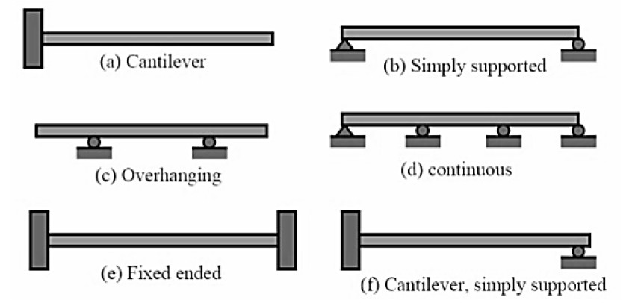
Types of Beams

Slide 3
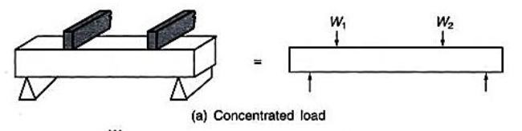
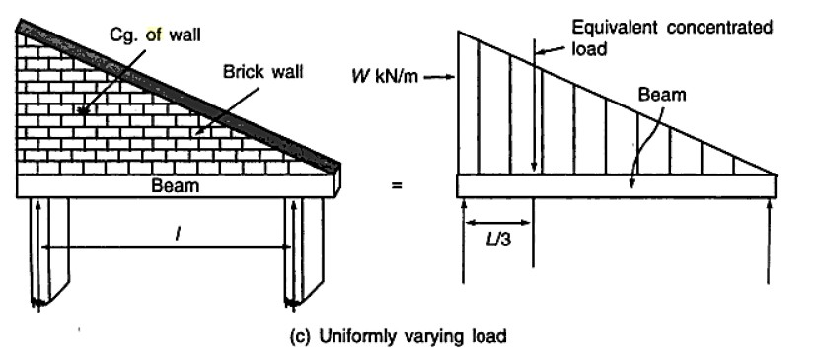
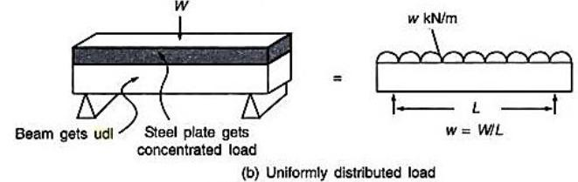
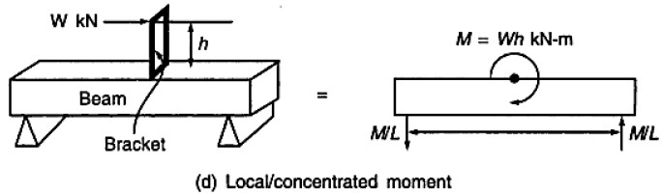
Types of Loads

Slide 4
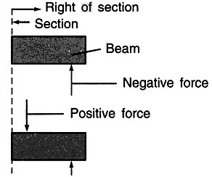
Shear Force Diagram (SFD)
A shear force which tends to rotate the beam in clockwise direction is positive and vice versa
A shear force (SF) is defined as the algebraic sum of all the vertical forces, either to the left or to the right hand side of the section
Shear Force Diagram: is graph connecting Shear Forces at various locations on the beam.

Slide 5
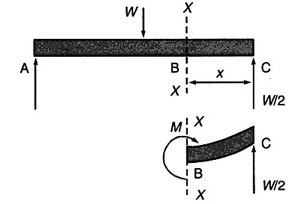
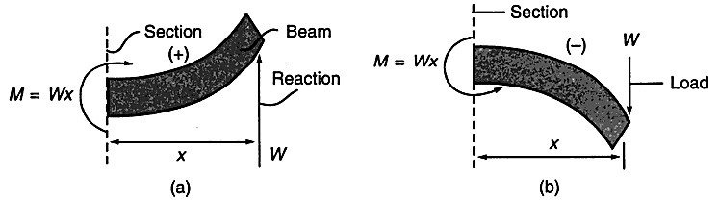
Bending Moment Diagram (BMD)
A bending moment (BM) is defined as the algebraic sum of the moments of all the forces either to the left or to the right of a section.
BMD: Diagram is graph connecting bending moments at various locations

Slide 6
General Guidelines on Construction of SFD and BMD
The load, shear and bending moment diagrams should be constructed one below the other, in that order, all with the same horizontal scale.
The dimension on the beam need not be scaled but should be relative and proportionate
Ordinates (i.e., BM and SF values) need not be plotted to scale but should be relative. Curvature may need to be exaggerated for clarity.
Principal ordinates (BM and SF values at salient points) should be labeled on both SFD and BMD.
7

Slide 7
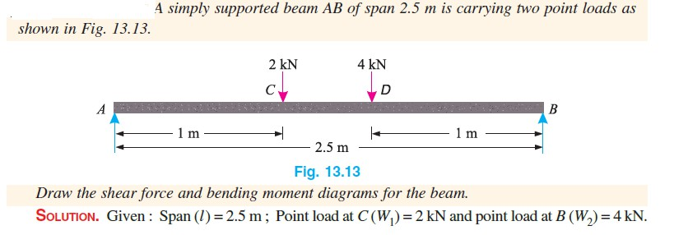
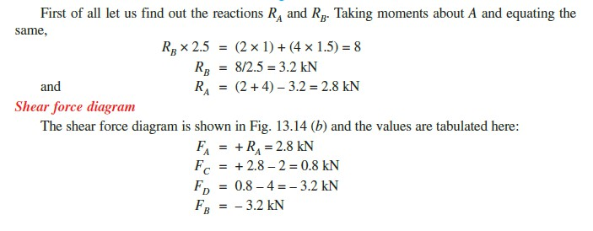

Slide 8
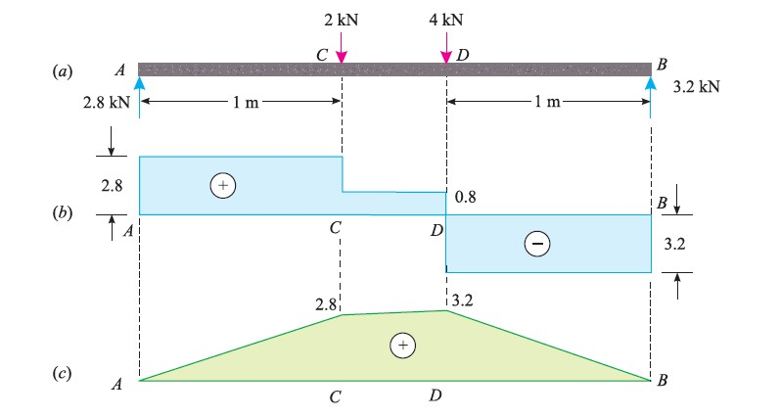

Slide 9
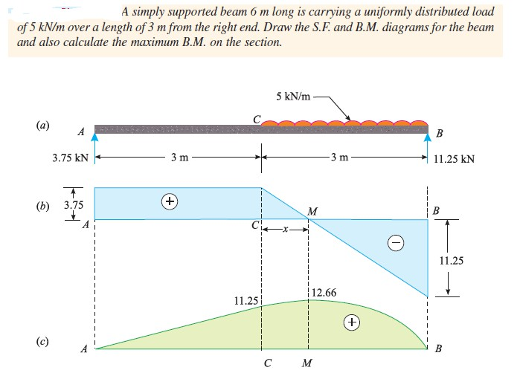

Slide 10
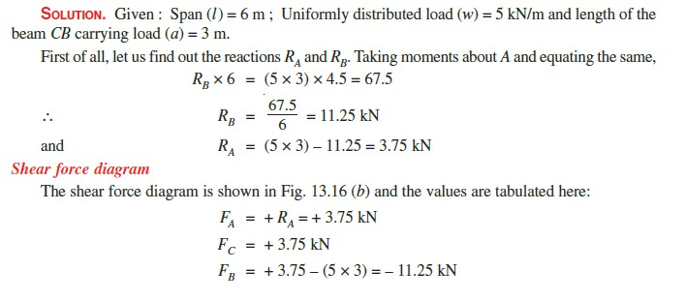

Slide 11
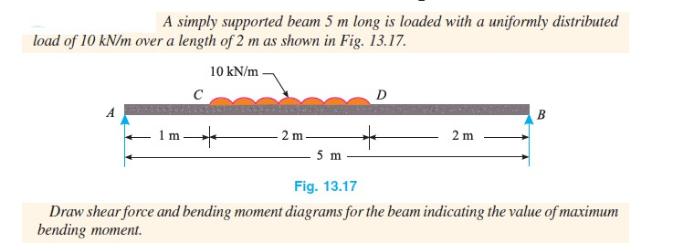
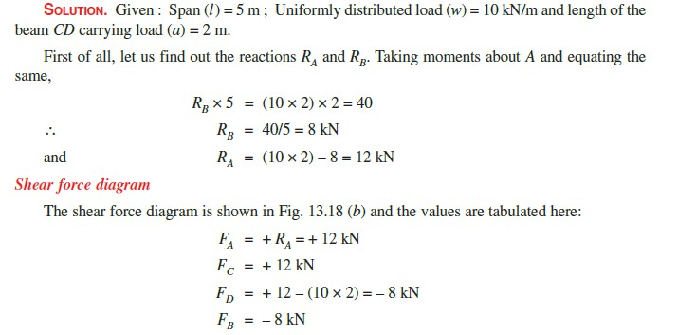

Slide 12
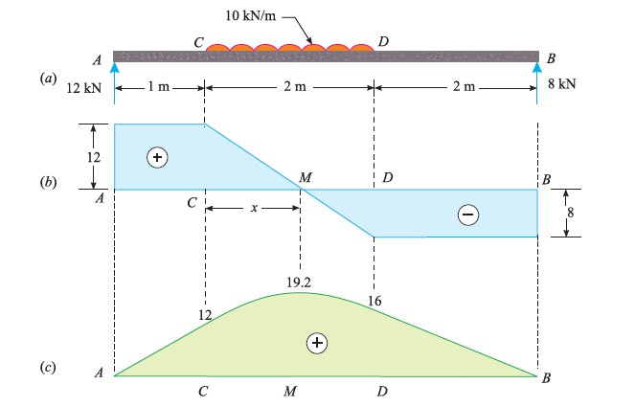

Slide 13
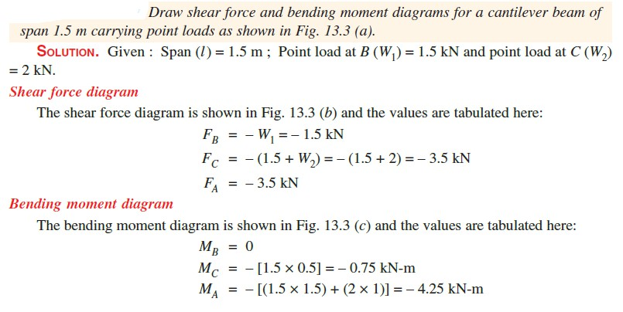

Slide 14
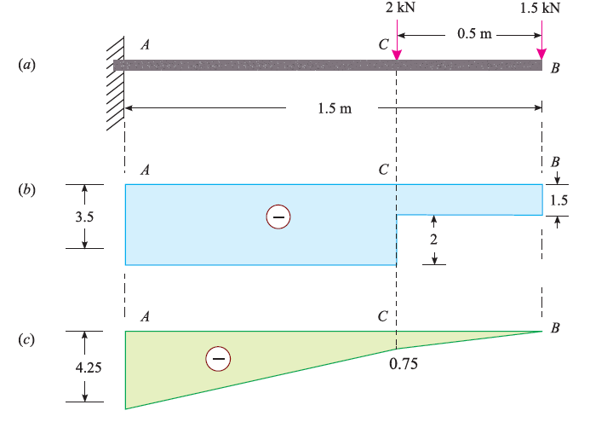

Slide 15
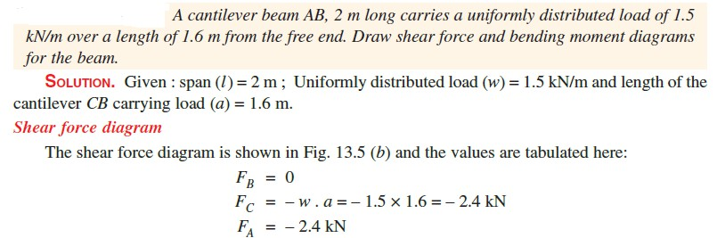
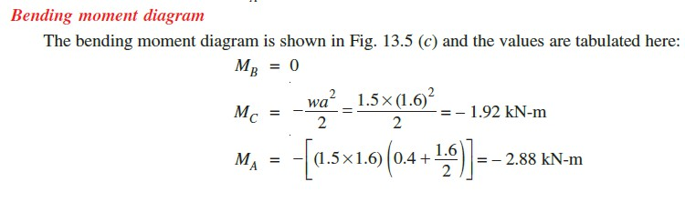

Slide 16
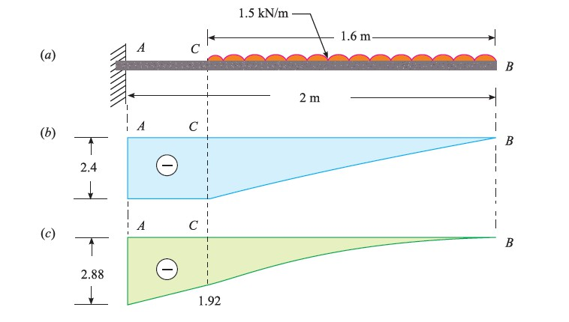

Slide 17
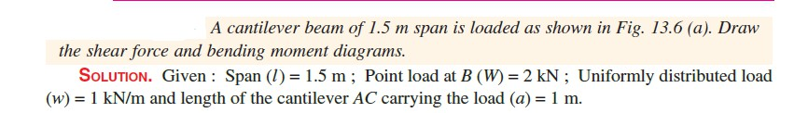
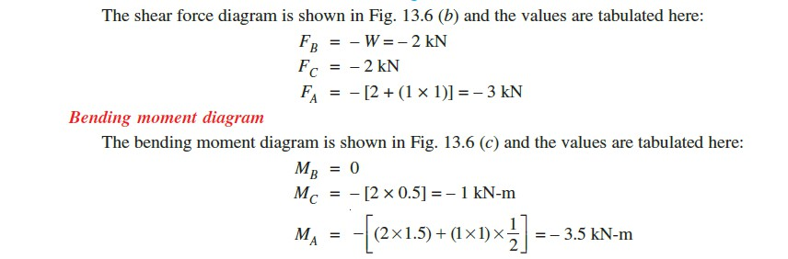

Slide 18
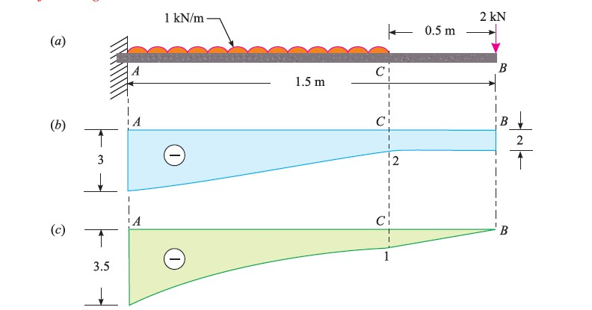

Slide 19
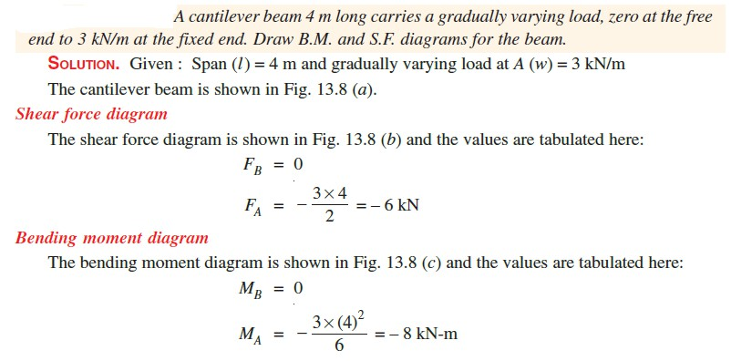

Slide 20
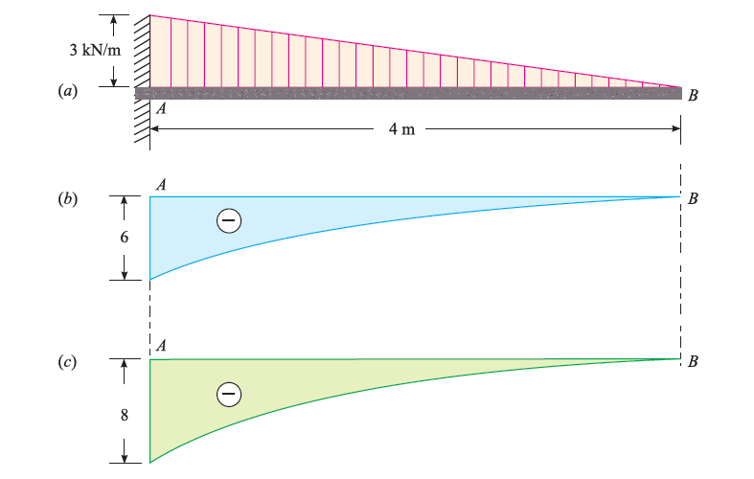

Slide 21
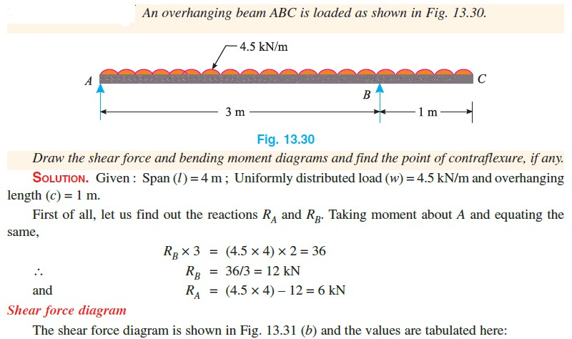

Slide 22
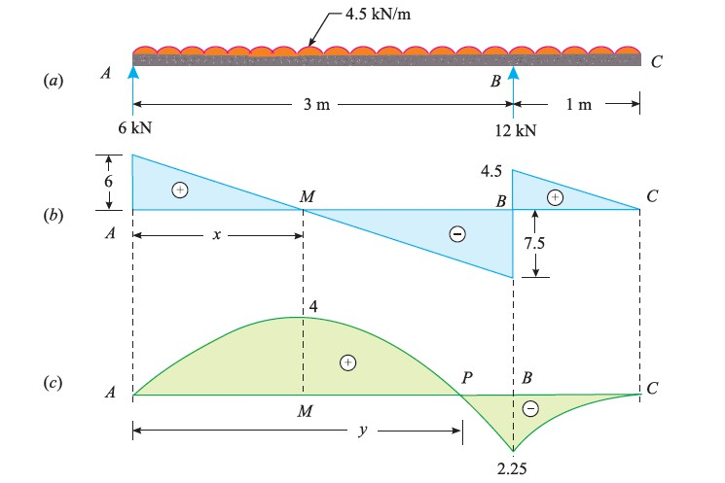

Slide 23
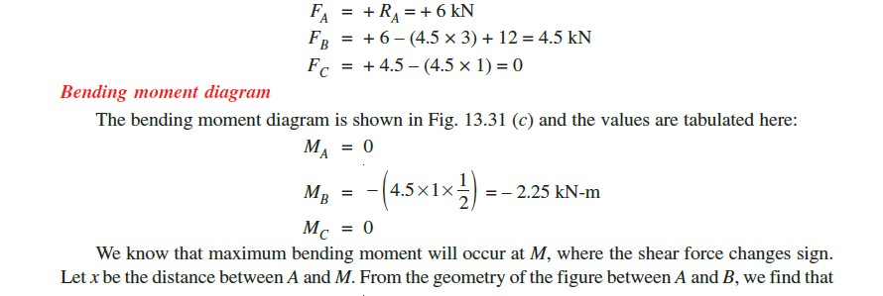

Slide 24
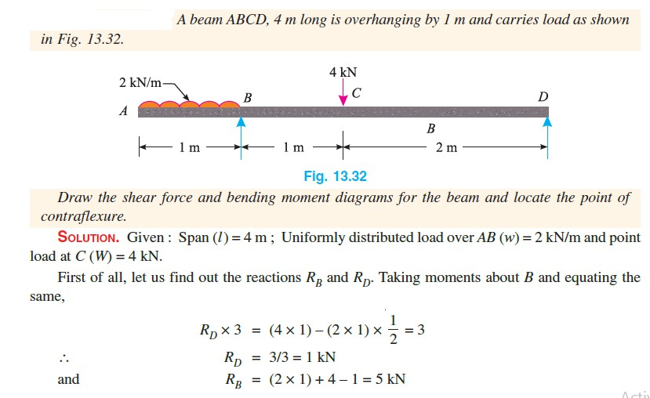

Slide 25
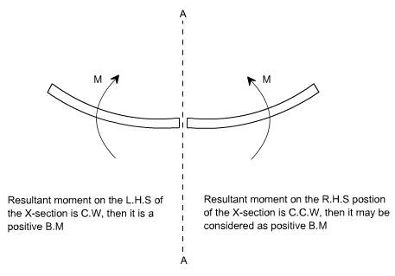
Sign Conventions for the Bending Moment:
a) Positive Bending Moment (Sagging)

Slide 26
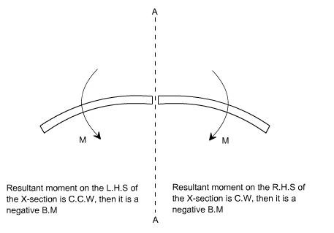
b) Negative Bending Moment(Hogging)

Slide 27
Point of Contraflexure:
It corresponds to a point where the bending moment changes the sign, hence in order to find the point of contraflexures obviously the B.M would change its sign when it cuts the X-axis therefore to get the points of contraflexure equate the bending moment equation equal to zero. The fibre stress is zero at such sections

Slide 28
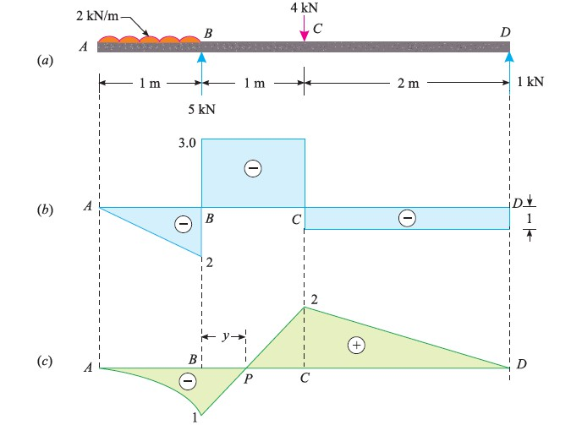

Slide 29
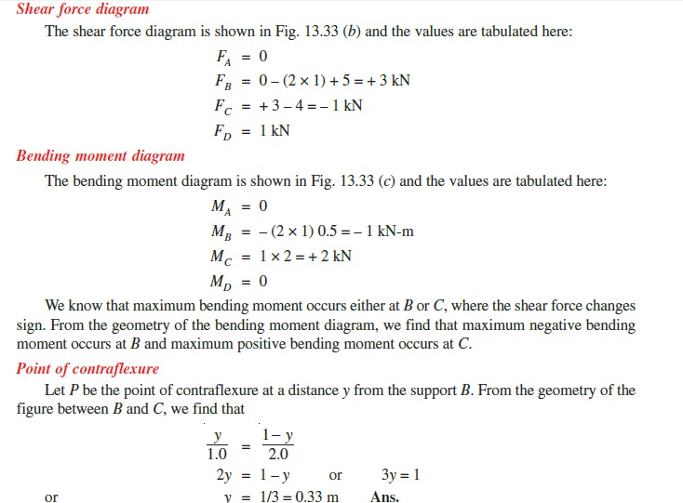

Slide 30
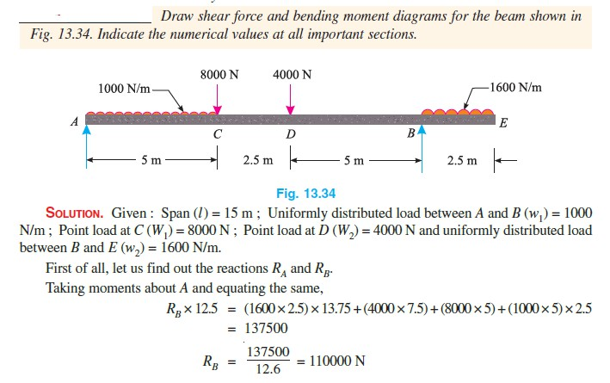

Slide 31
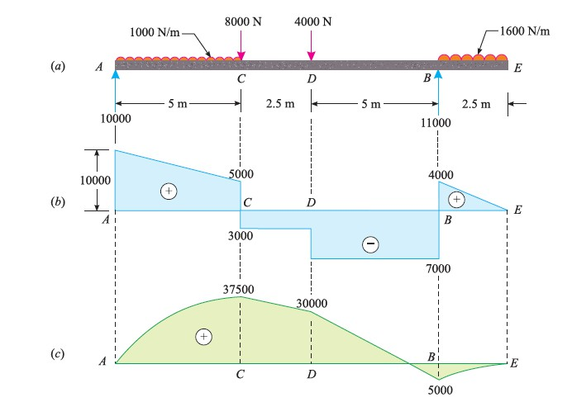

Slide 32
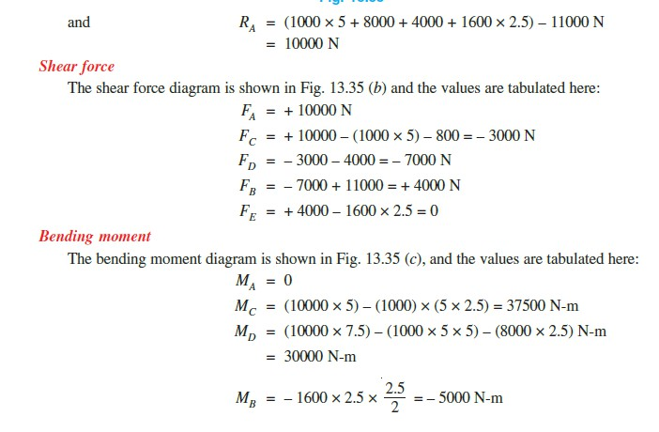

Slide 33
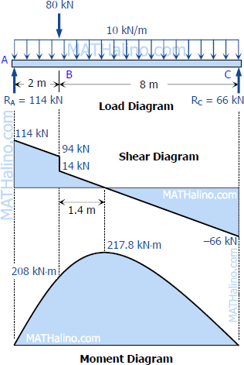
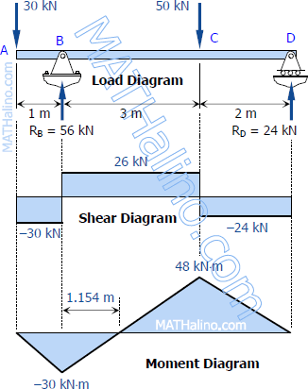

Slide 34
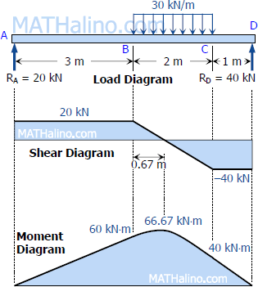
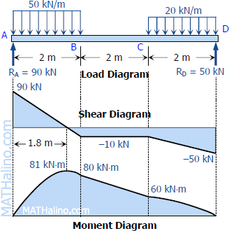

Slide 35
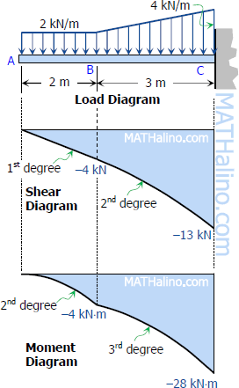
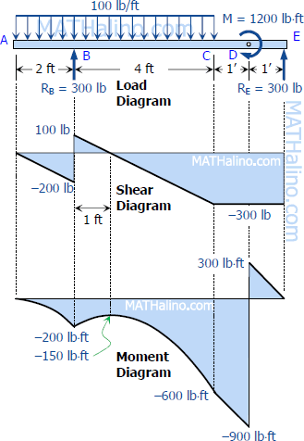

Slide 36
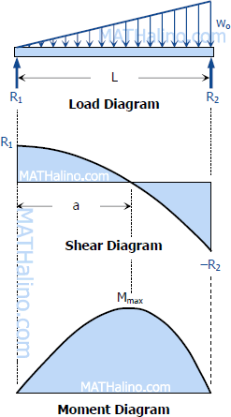
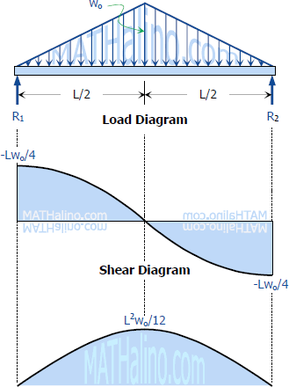

Slide 37
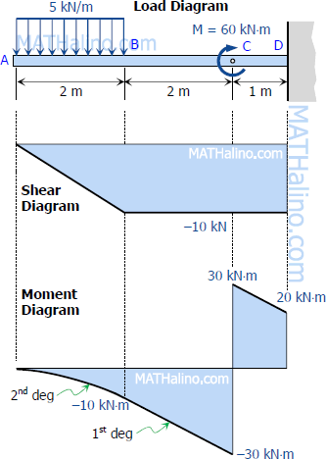
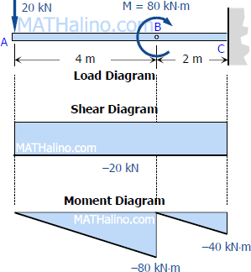

Slide 38
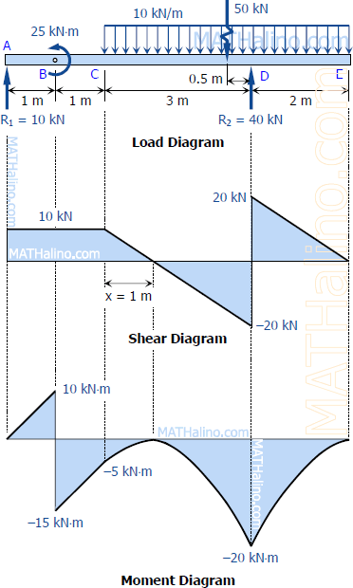
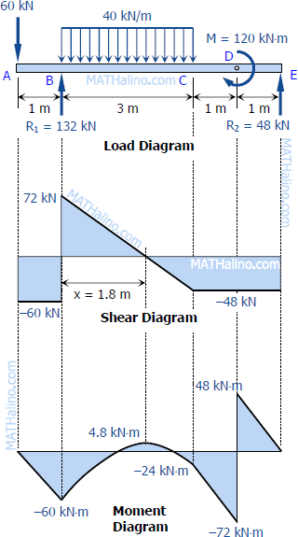

Slide 39



Interpretations
 | Types of Loading | Shape of Shear Force Diagram | Shape of Bending Moment Diagram
 | Point Load | Sudden Jump at load and constant at other locations | Linearly Varying Graph (Straight Line)
 | Uniformly Distributed Load (UDL) | Linearly Varying Graph (Straight Line) | Parabolic Graph (Smooth Curve)
 | Uniformly Varying Load (UDL) | Parabolic Graph (Smooth Curve) | Cubically varying Graph (Curve)
 | Moment Couple | No effect | Sudden Jump at Moment and constant at other locations 40

Slide 40
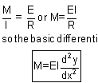



Relationship between shear force, bending moment
41

